Slide 1
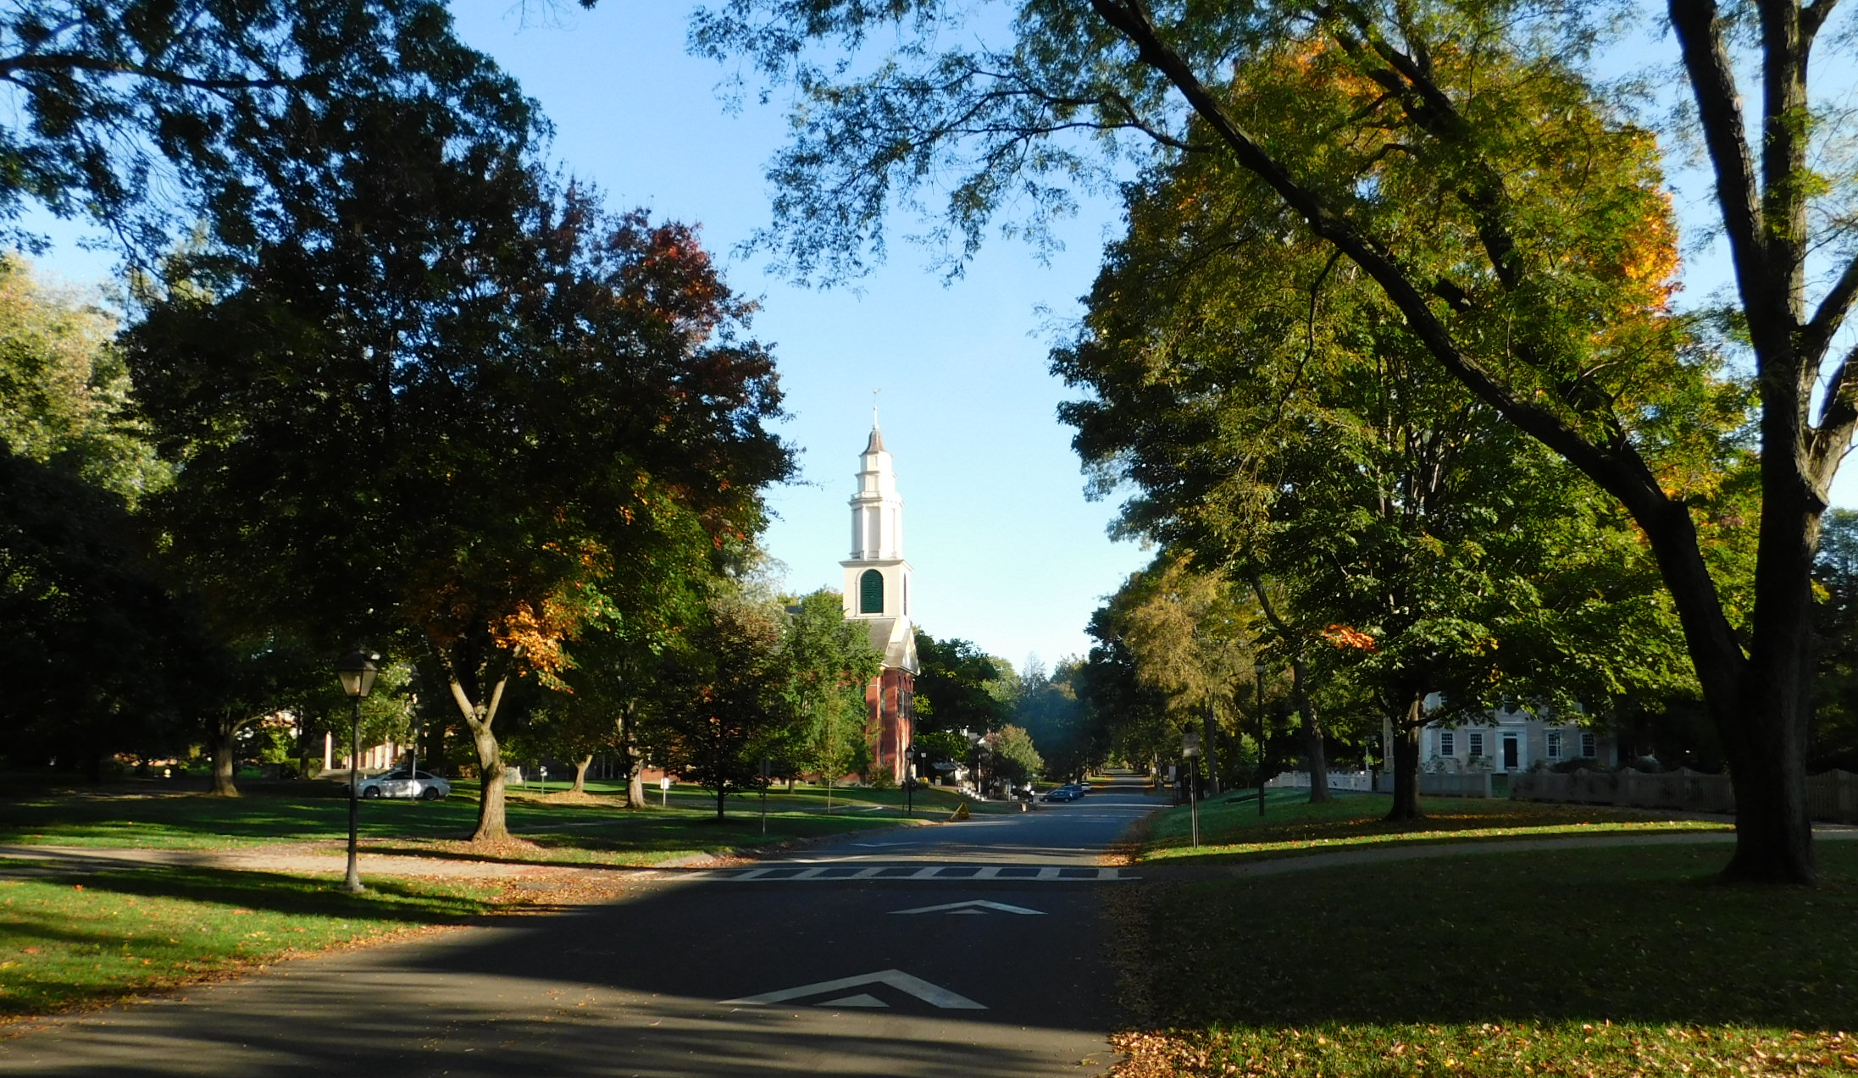
The World of Edward Hitchcock
Then and Now
Many of the landmarks in the life of Edward Hitchcock – homes, institutions, buildings, and points of geographical interest – are still visible today, 160 years after his death. This 4-minute slide show presents 45 images from the world of Edward Hitchcock, past and present.

Slide 2
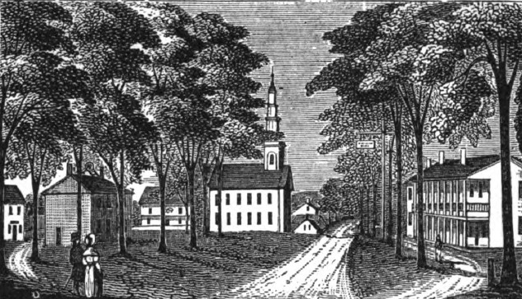
The World of Edward Hitchcock
Then and Now
1840
Today
Deerfield, Massachusetts

Slide 3
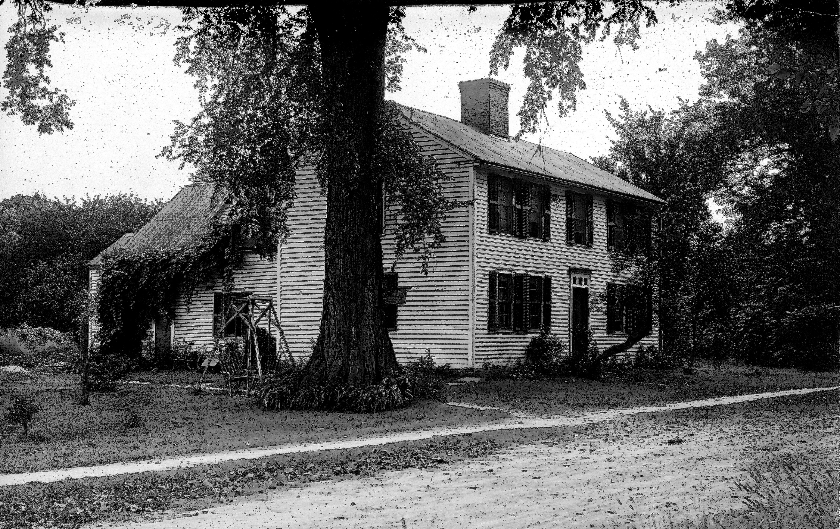
The World of Edward Hitchcock
Then and Now
Today
ca 1910
The house in Deerfield where Edward Hitchcock was born in 1793

Slide 4
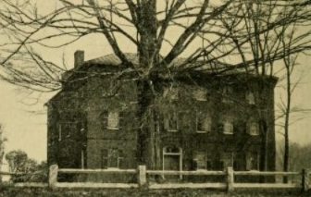
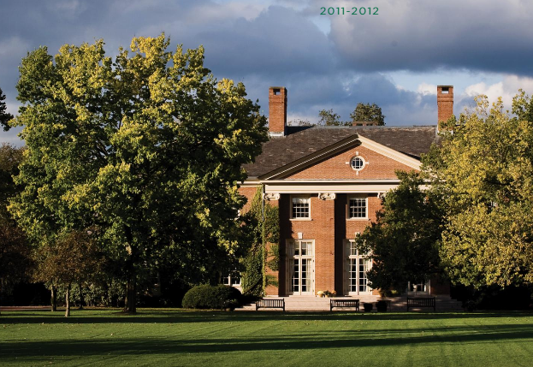
The World of Edward Hitchcock
Then and Now
ca 1850
Today
Deerfield Academy opened in 1799. Edward Hitchcock attended from 1804 to 1809.

Slide 5
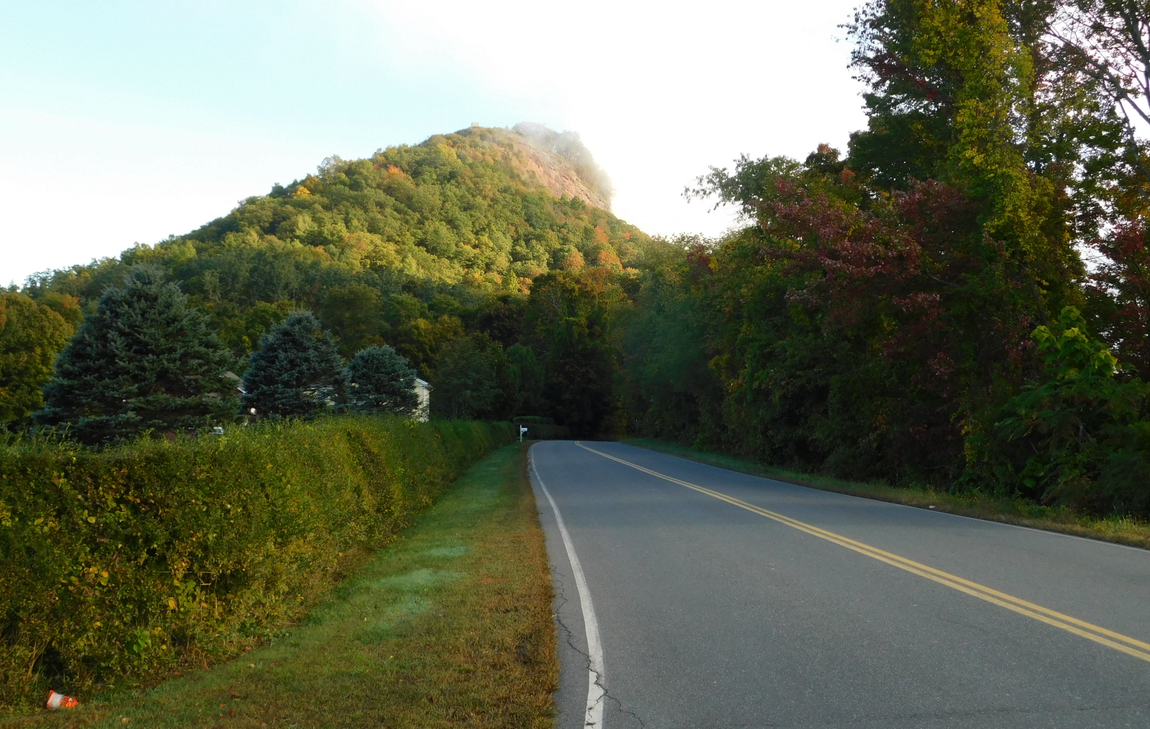
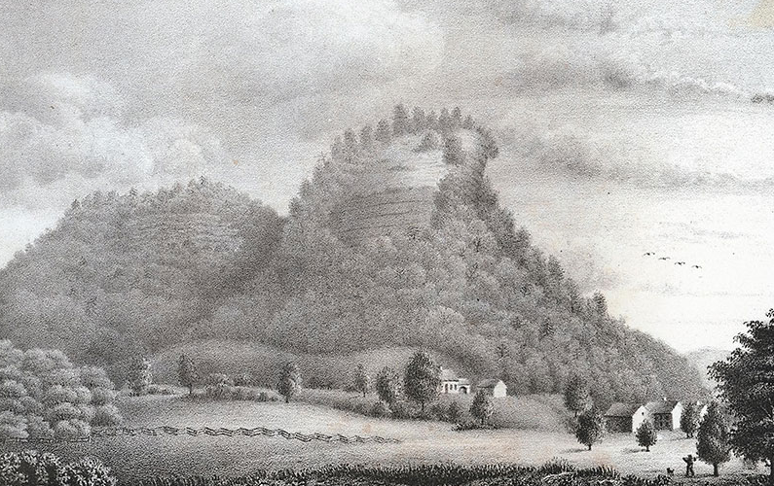
The World of Edward Hitchcock
Then and Now
1831 by Orra White Hitchcock
Today
Mount Sugarloaf,
Deerfield

Slide 6
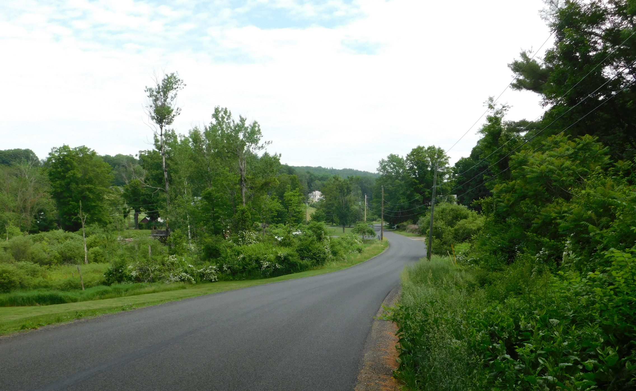
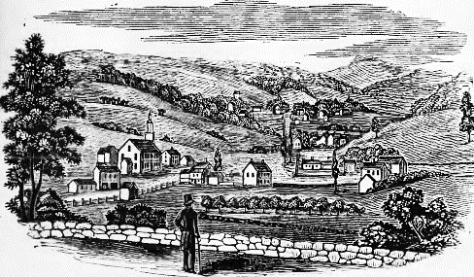
The World of Edward Hitchcock
Then and Now
ca 1838
Today
Conway, Massachusetts, home of Edward and Orra Hitchcock from 1821 to 1825.

Slide 7
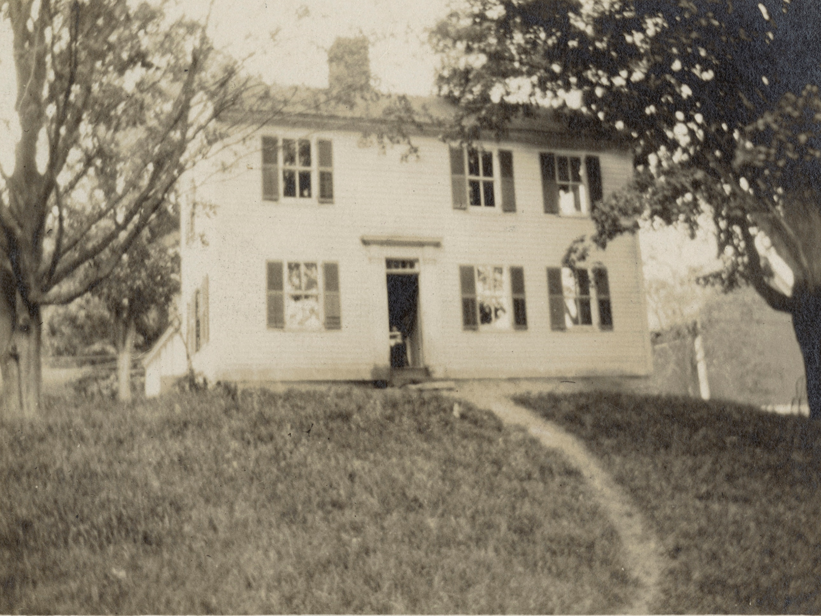
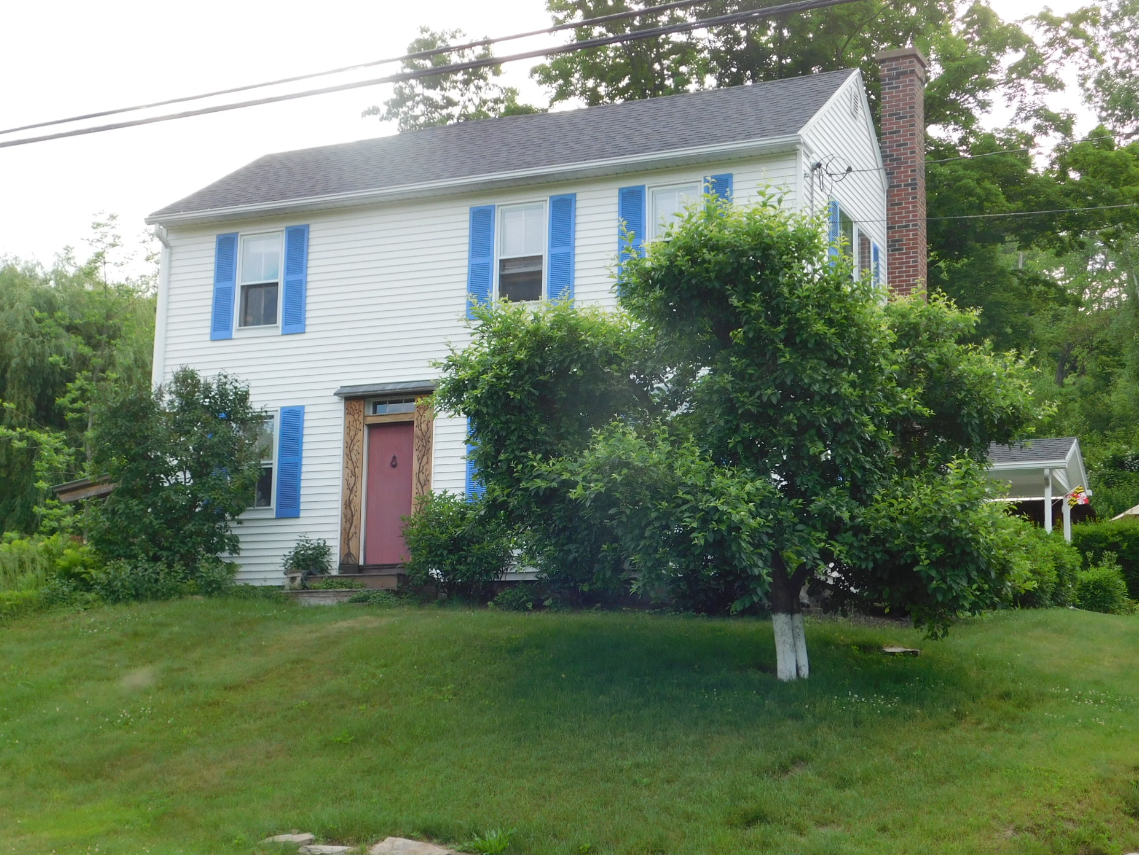
The World of Edward Hitchcock
Then and Now
ca 1940
Today
The home of the Hitchcocks in Conway

Slide 8
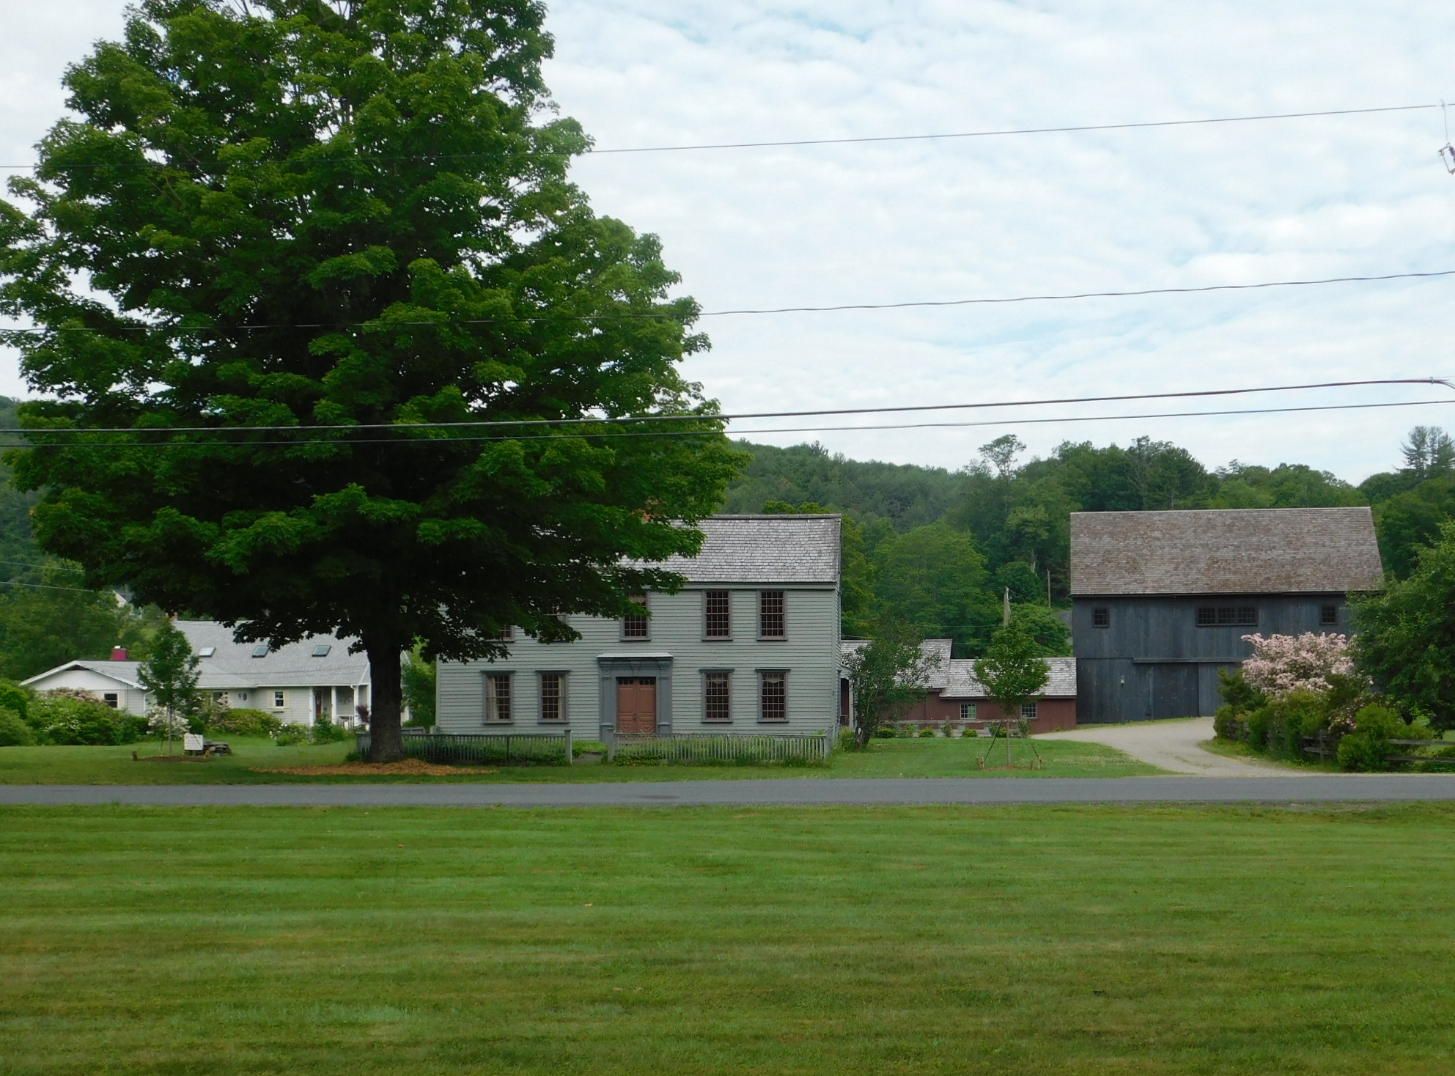
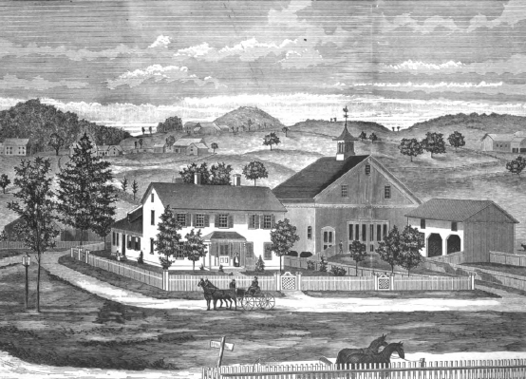
The World of Edward Hitchcock
Then and Now
Today
Today
1840
A Conway farmhouse

Slide 9
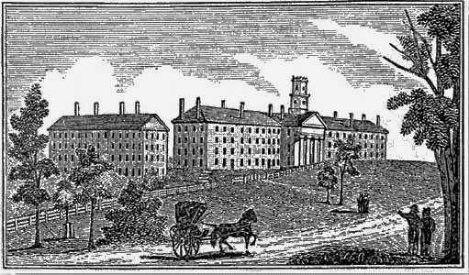
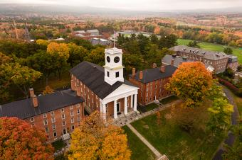
The World of Edward Hitchcock
Then and Now
Today
ca 1855
Amherst College. Edward Hitchcock was on the faculty from 1825 to 1863.

Slide 10
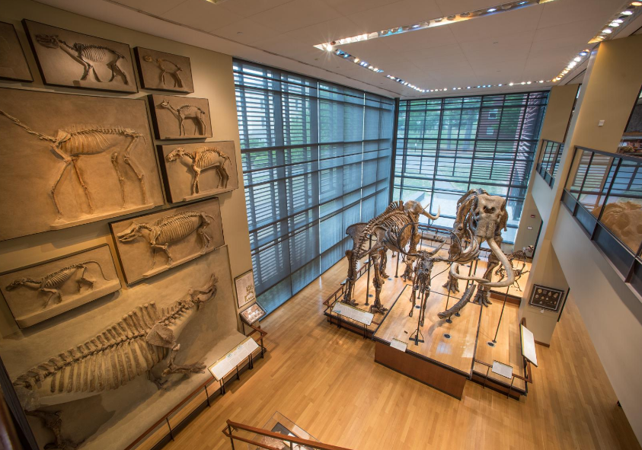
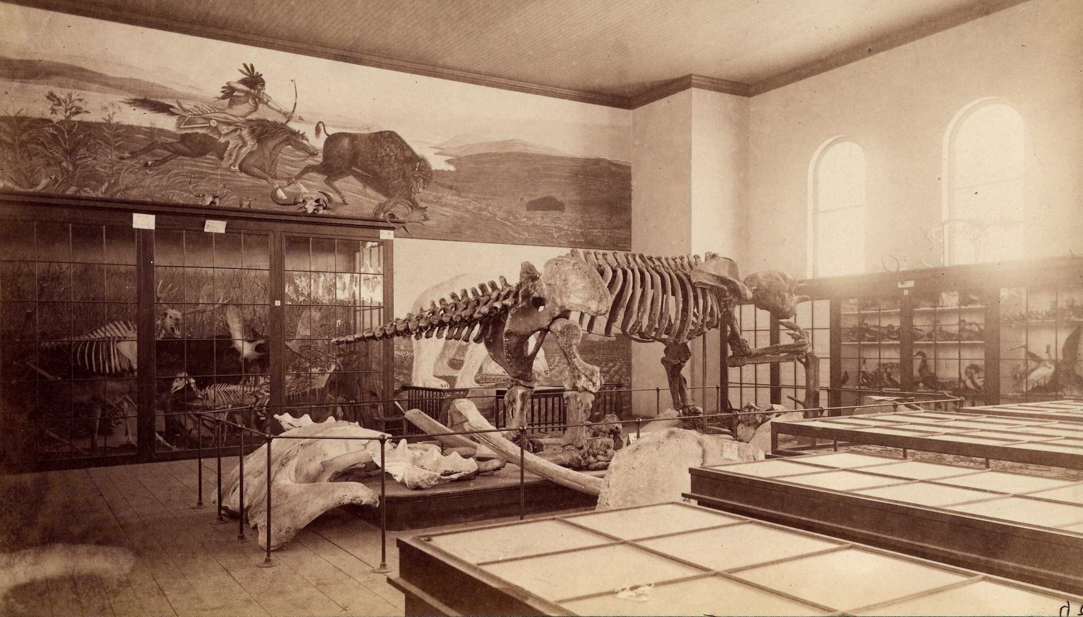
The World of Edward Hitchcock
Then and Now
1871
Today
The Appleton Cabinet and the Beneski Museum of Natural History
Amherst College

Slide 11
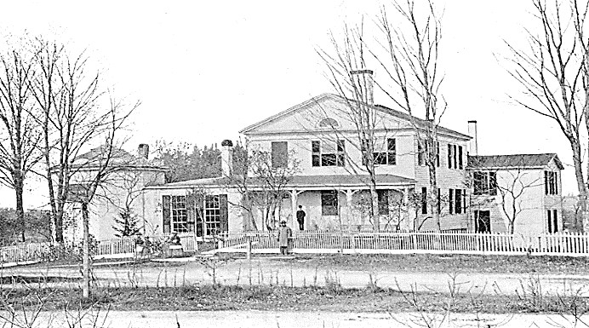
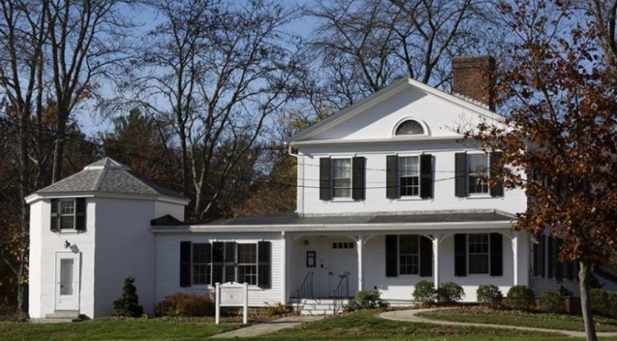
The World of Edward Hitchcock
Then and Now
1900
Today
The Hitchcock homestead in Amherst. Edward and Orra purchased this house in 1828 and lived there the remainder of their lives.

Slide 12
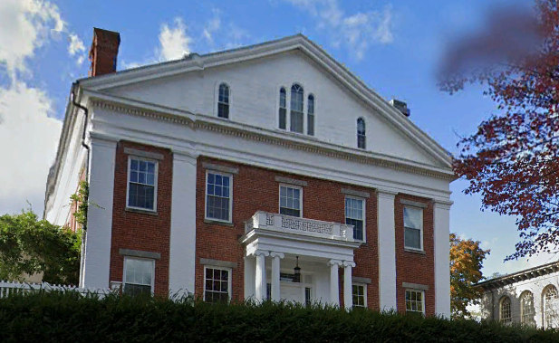
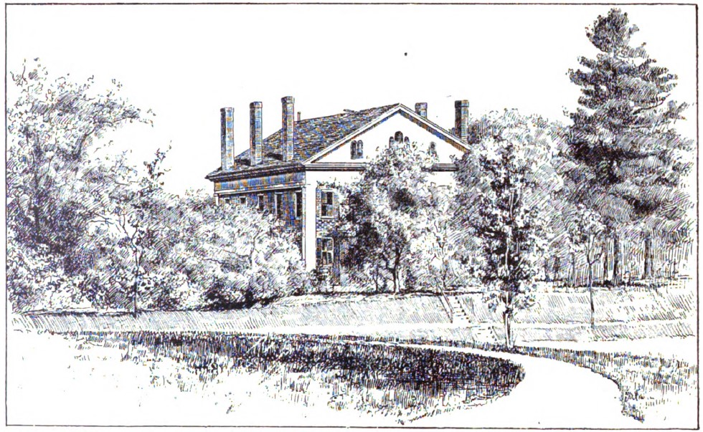
The World of Edward Hitchcock
Then and Now
1840
Today
The President’s House at Amherst College where the Hitchcocks lived from 1845 to 1854.

Slide 13
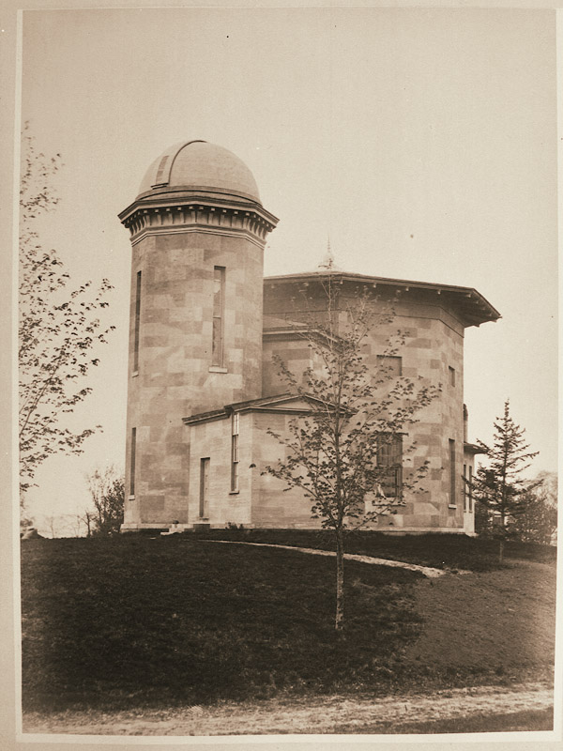
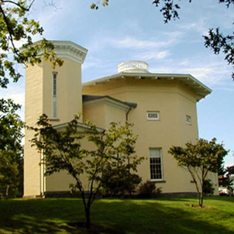
The World of Edward Hitchcock
Then and Now
Today
1855
Woods Cabinet and Lawrence Observatory, Amherst College, constructed in 1847.

Slide 14
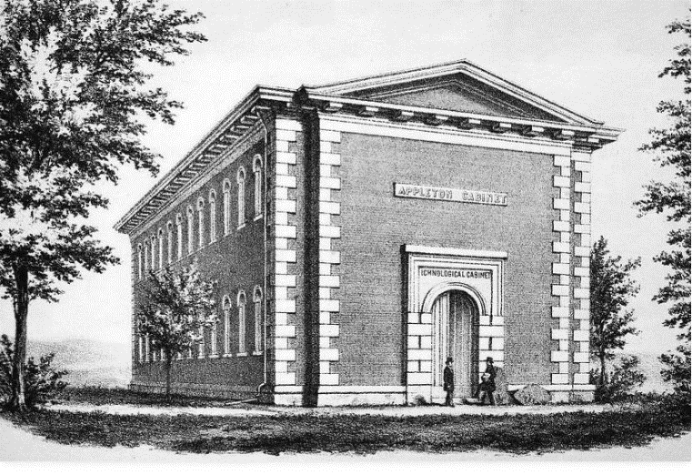
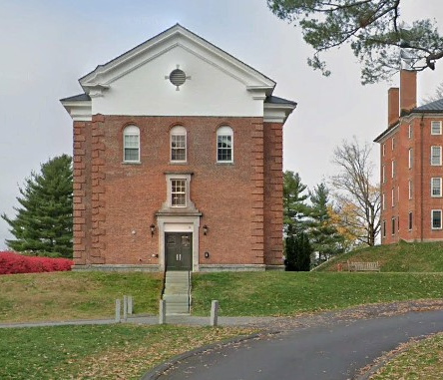
The World of Edward Hitchcock
Then and Now
Today
ca 1855
Appleton Cabinet, Amherst College, built in 1855.

Slide 15
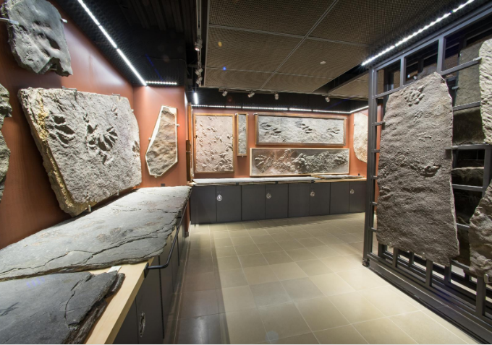
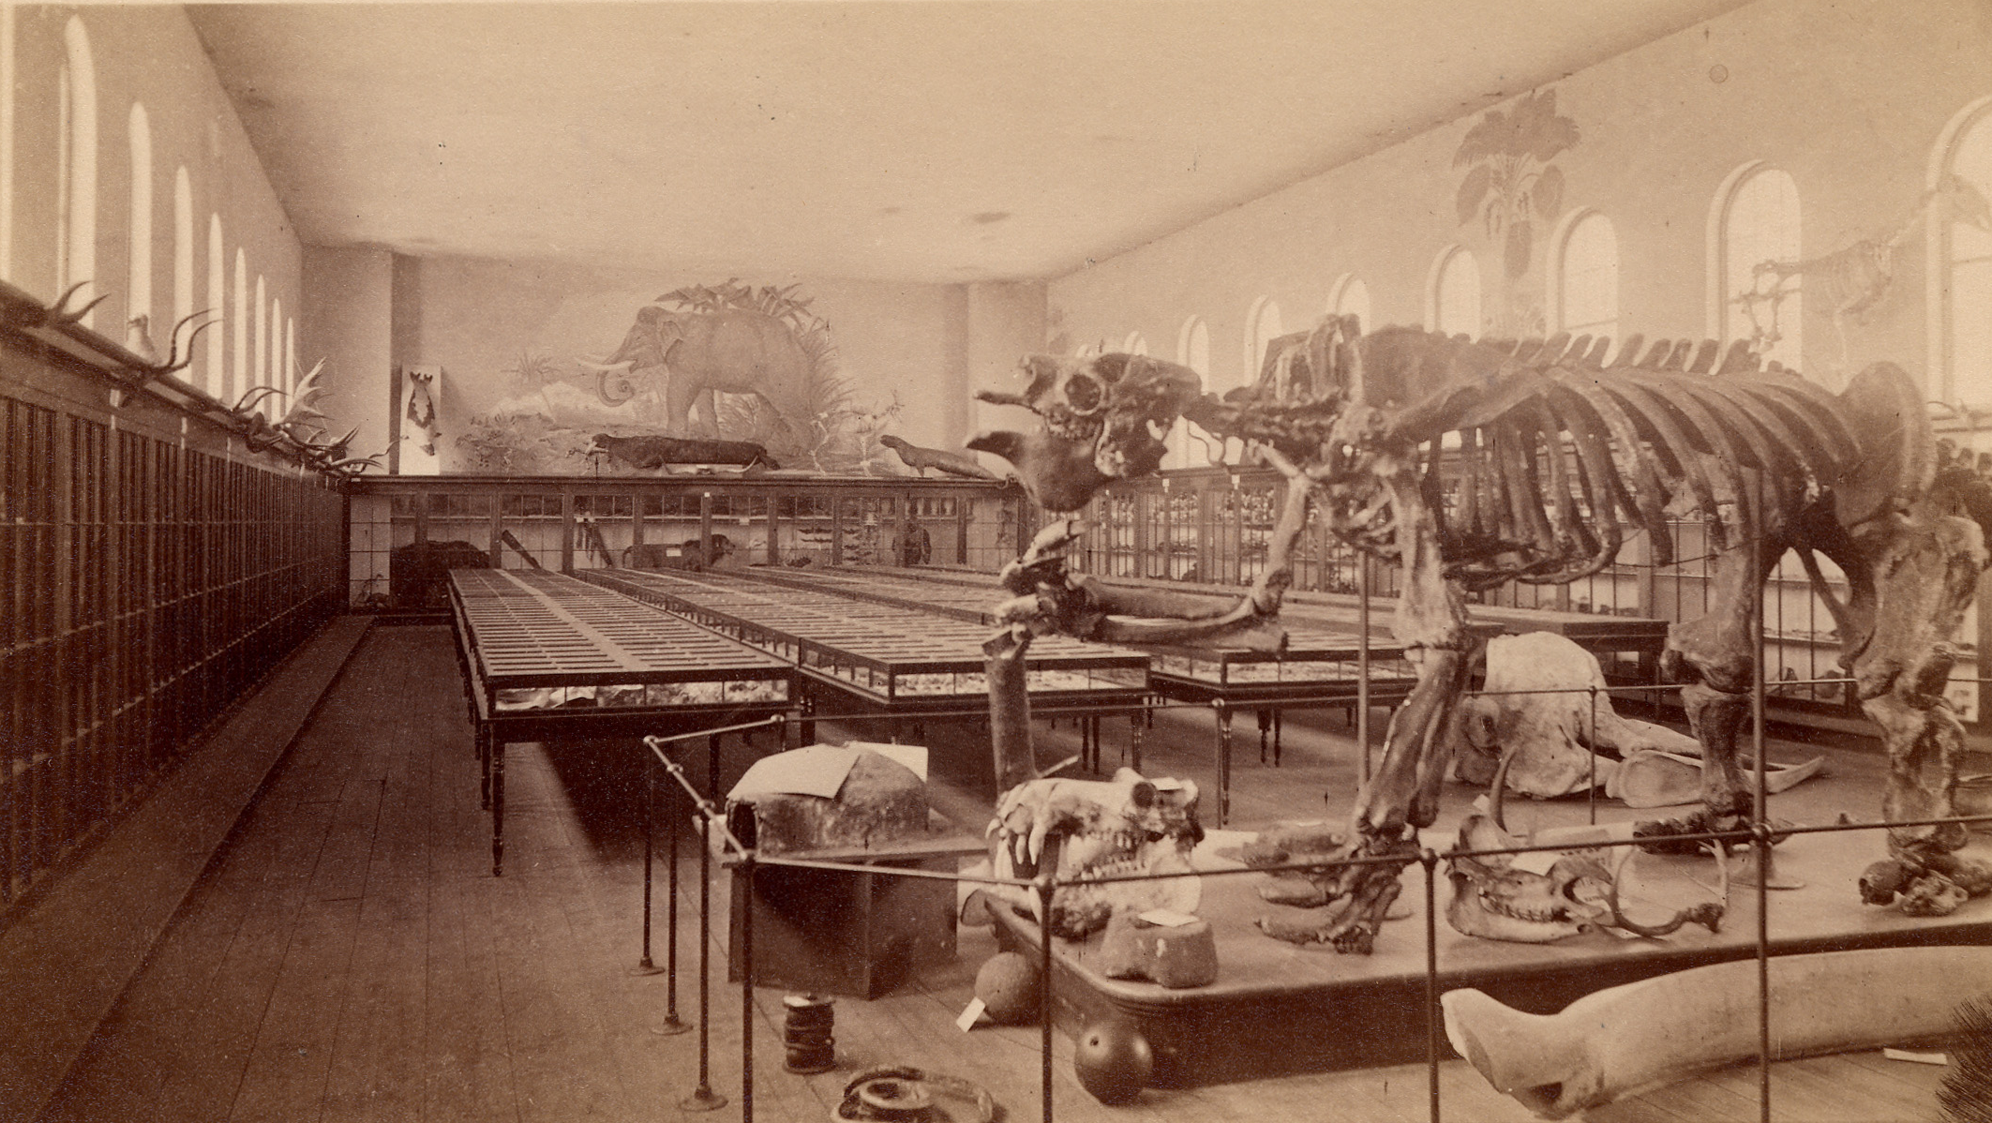
The World of Edward Hitchcock
Then and Now
ca 1879
Today
Hitchcock’s Ichnological Collection, Amherst College

Slide 16
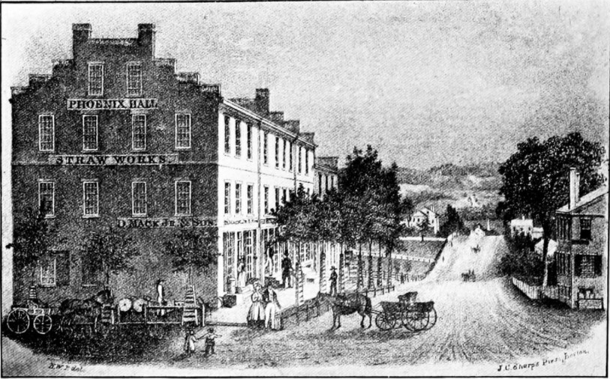
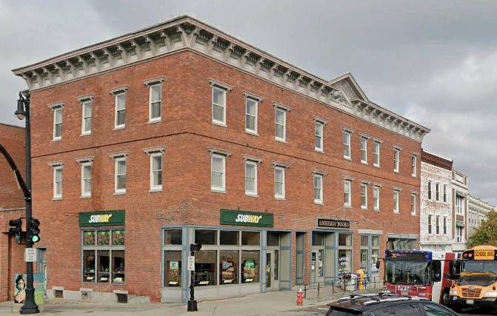
The World of Edward Hitchcock
Then and Now
1840
Today
Phoenix Row in the center of Amherst village

Slide 17
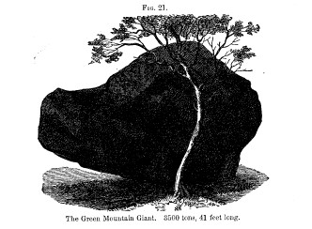
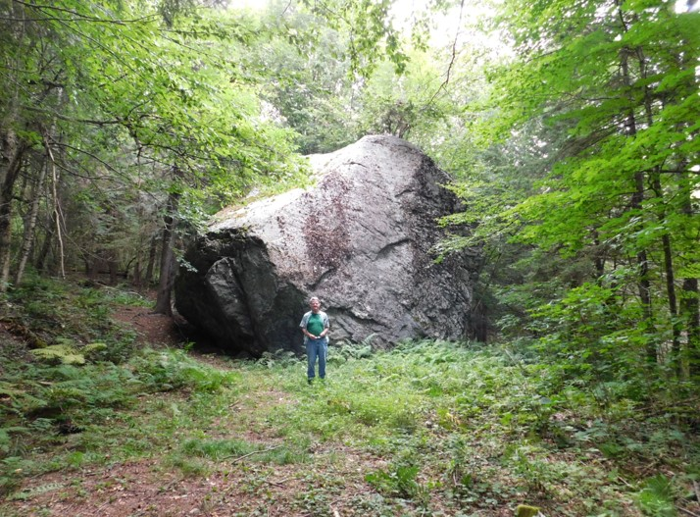
The World of Edward Hitchcock
Then and Now
1841
Today
The Green Mountain Giant, Whitinsville, Vermont. Hitchcock wrote that it might be the largest glacial boulder in Vermont.

Slide 18
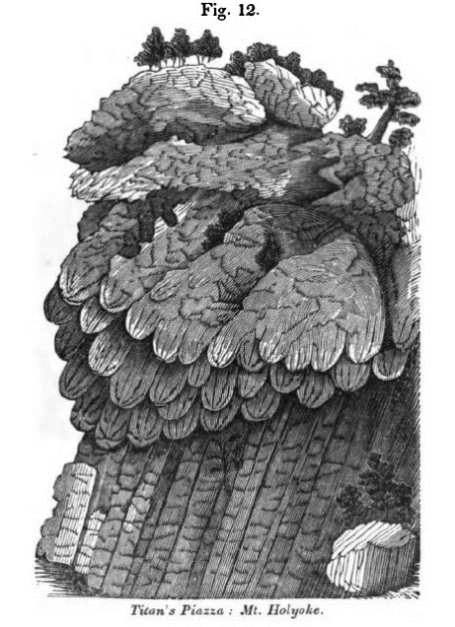
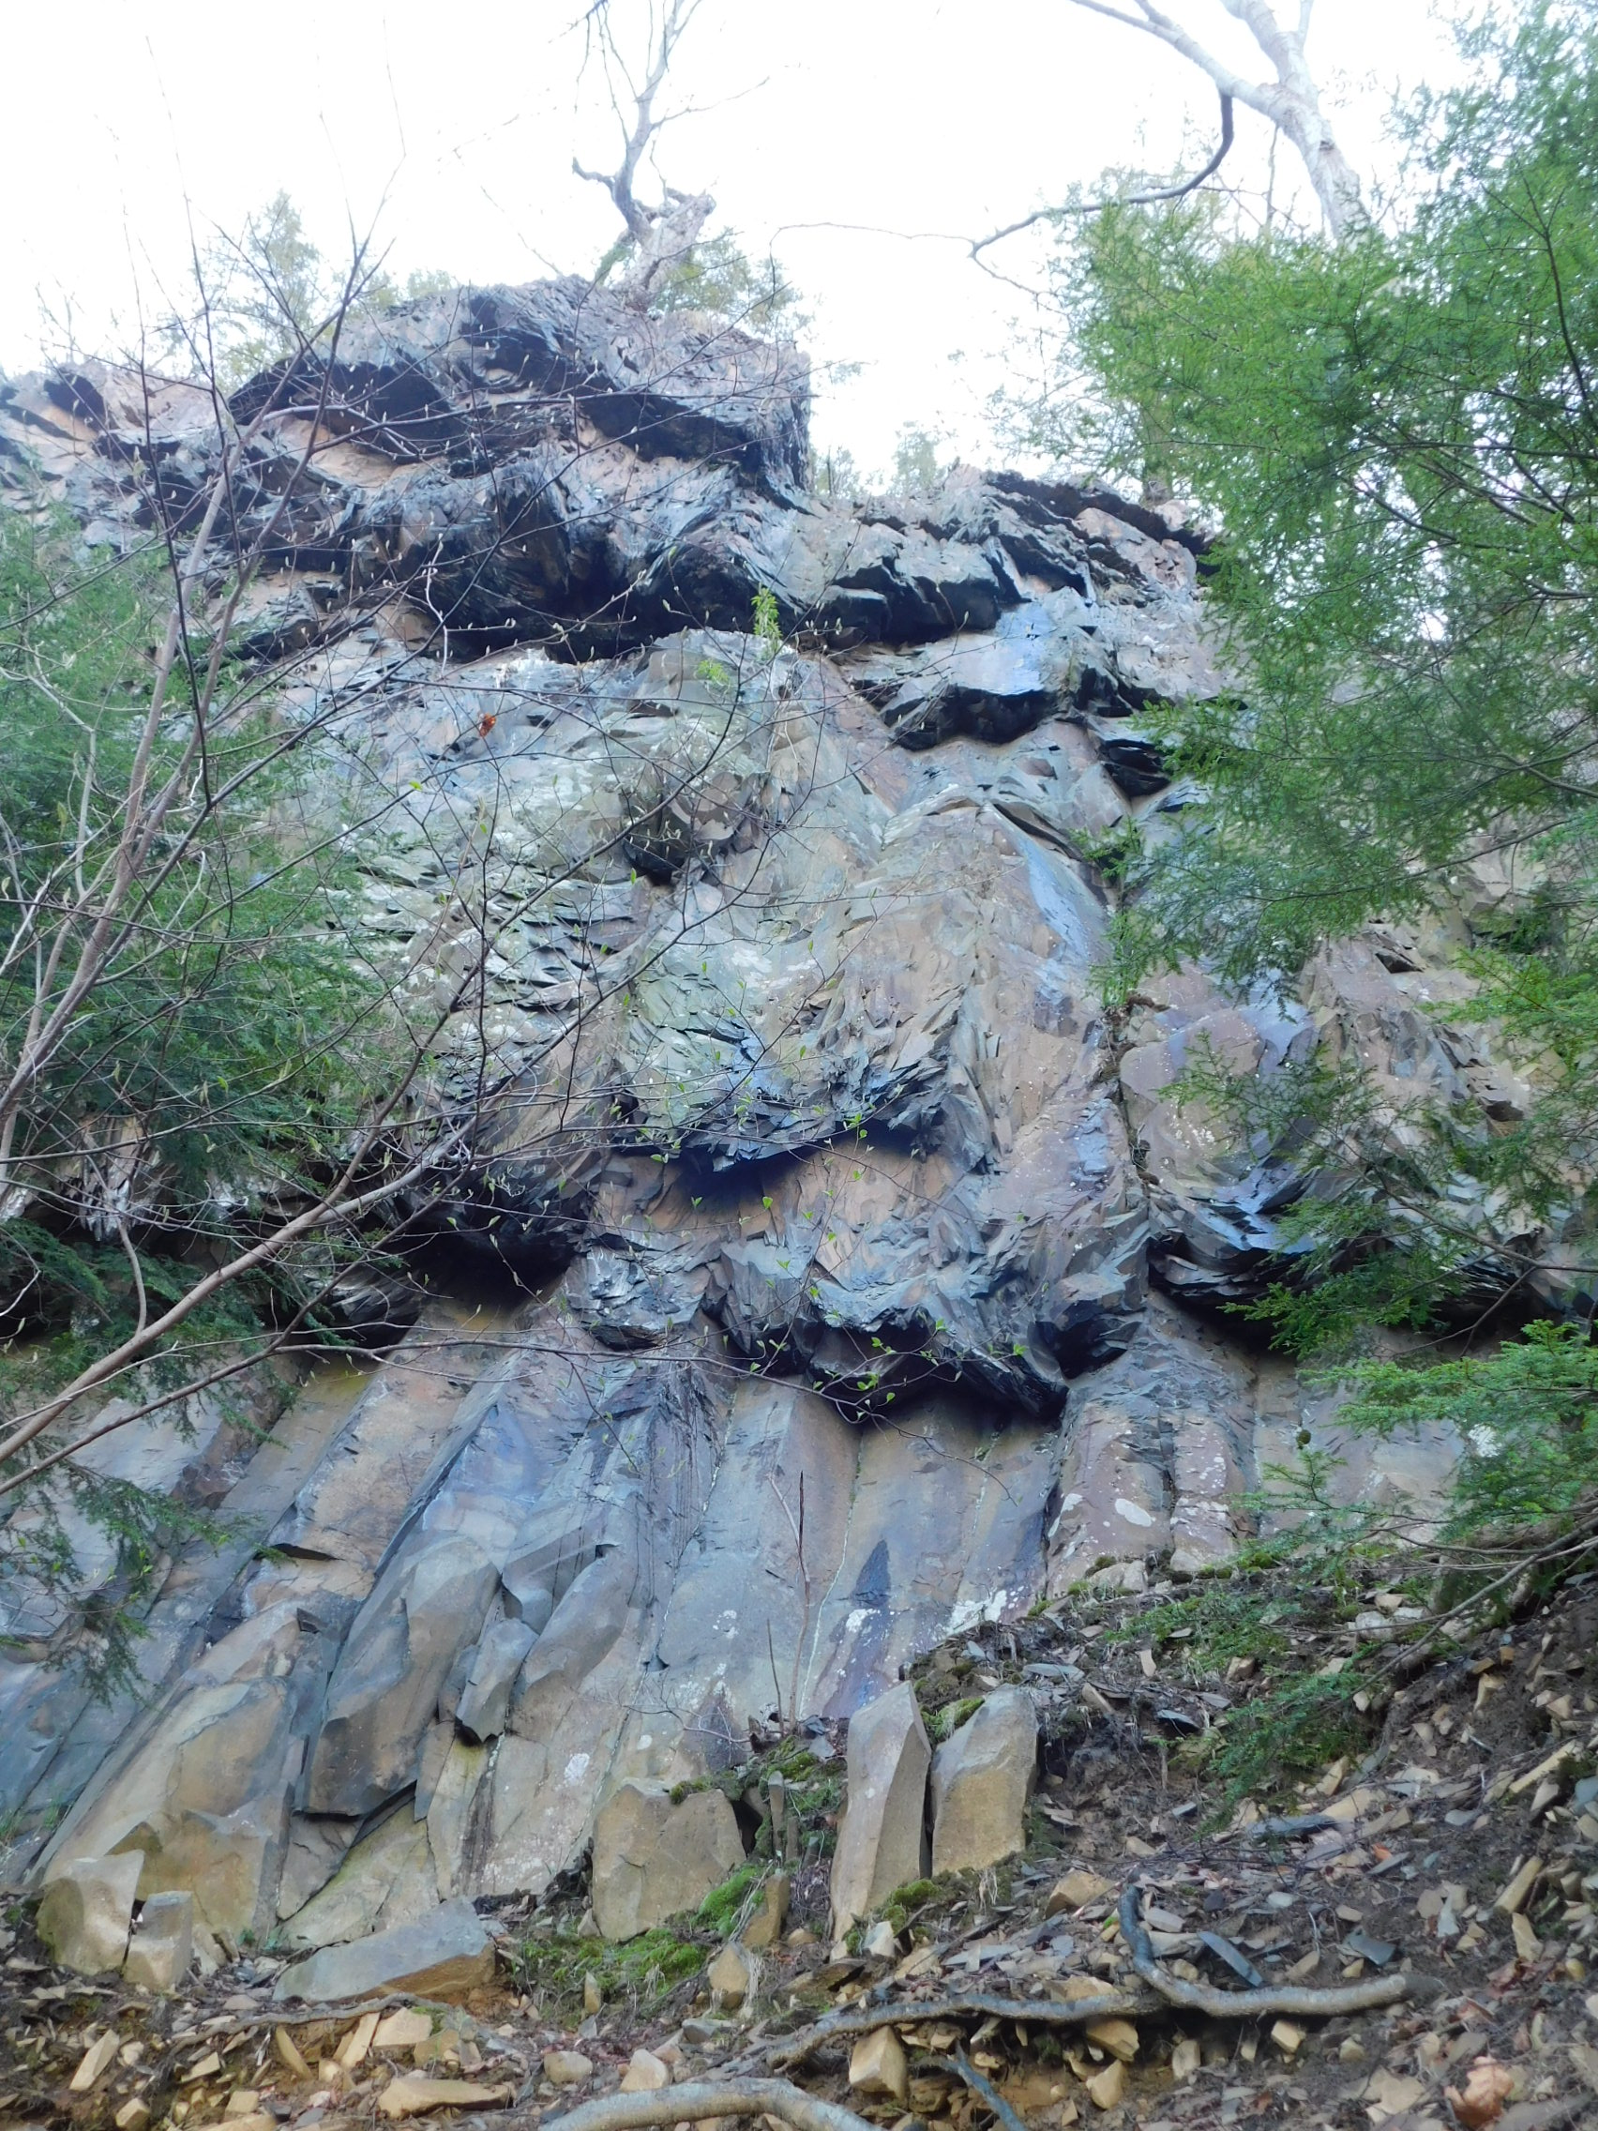
The World of Edward Hitchcock
Then and Now
1841
Today
Titan’s Piazza in Hadley, Massachusetts. Hitchcock wrote about it in “Basaltick Columns,” his first scientific article to appear in print in 1815.

Slide 19
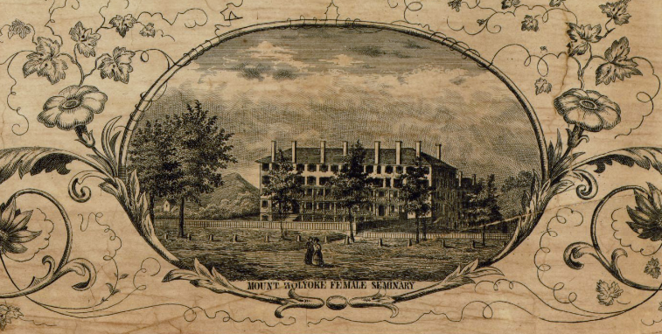
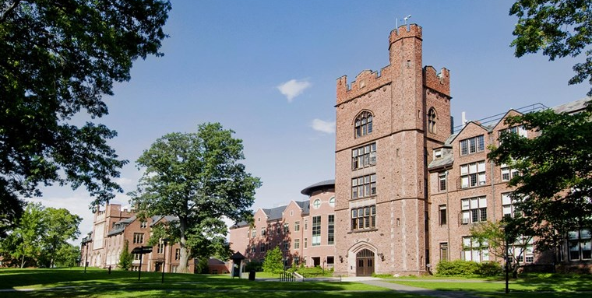
The World of Edward Hitchcock
Then and Now
1854
Today
Mount Holyoke College,
South Hadley, was founded in 1837. Hitchcock was on the Board of Trustees from 1837 until his death in 1864.

Slide 20
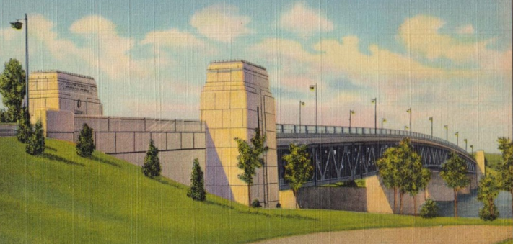
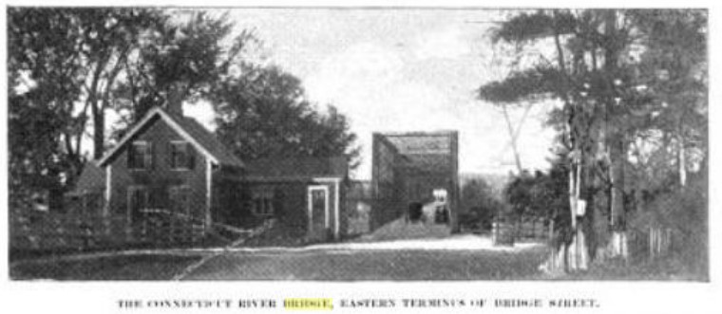
The World of Edward Hitchcock
Then and Now
1840
1939
Connecticut River Bridge, Hadley and Northampton

Slide 21
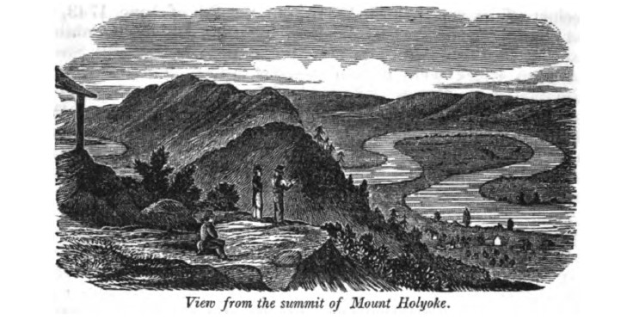
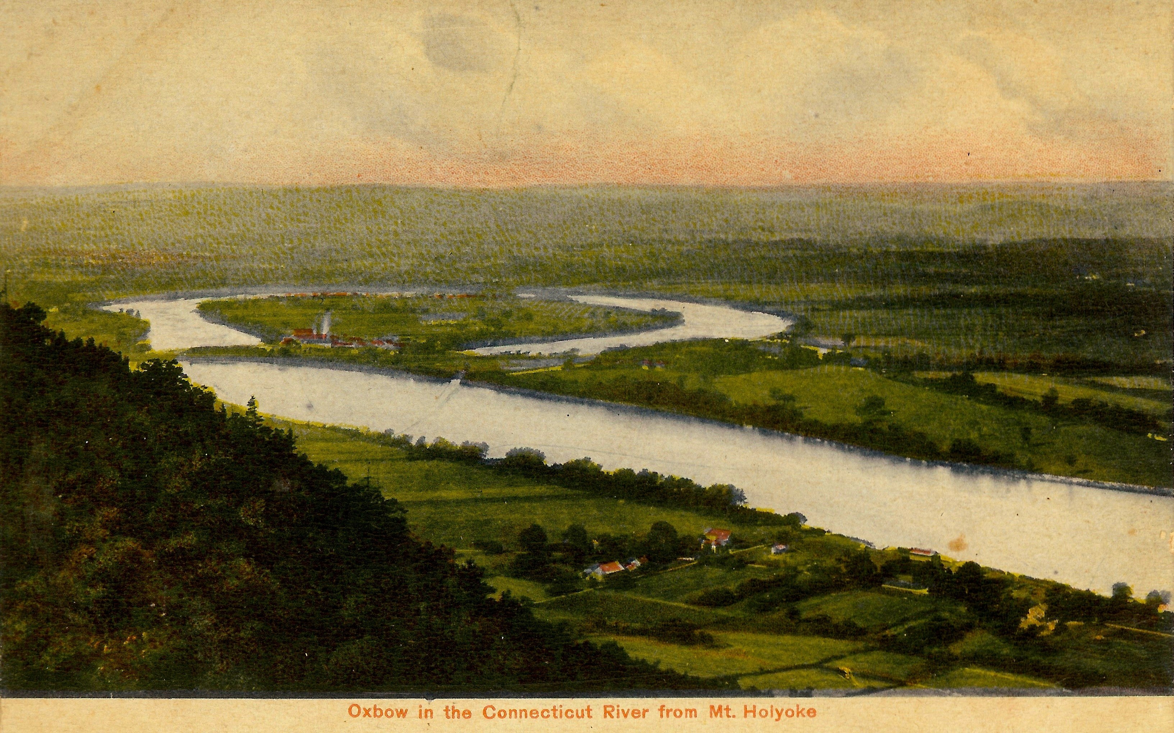
The World of Edward Hitchcock
Then and Now
1840
1910
Mount Holyoke in Hadley, Massachusetts, site of Hitchcock’s first mountain excursion as President of Amherst College.

Slide 22
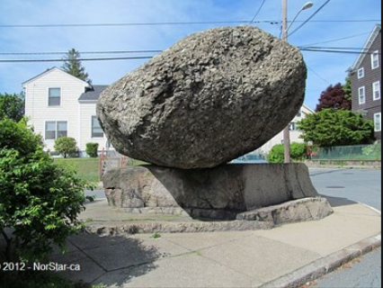
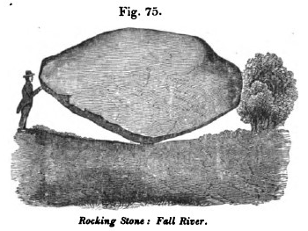
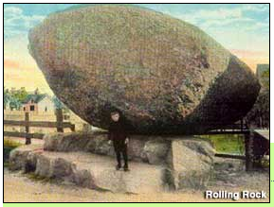
The World of Edward Hitchcock
Then and Now
1910
1840
Today
The “Rocking Stone,”
Fall River, Massachusetts, described in Hitchcock’s geological survey report in 1833.

Slide 23
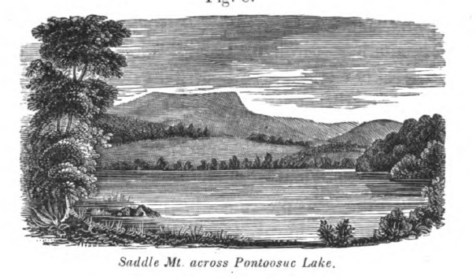
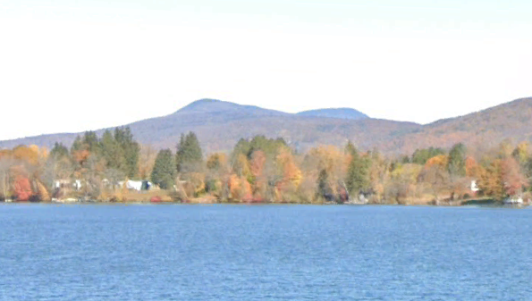
The World of Edward Hitchcock
Then and Now
1840
Today
Mount Greylock,
from Pittsfield, Massachusetts. Hitchcock wrote about “Saddle Mountain” in his geological survey reports of 1833 and 1841.

